Slide 1
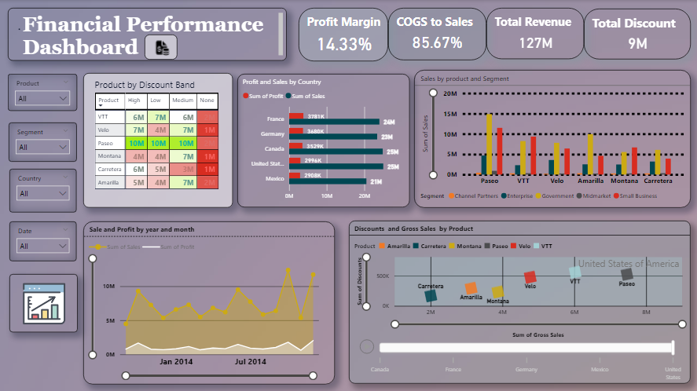
Finance Performance Dashboard Presentation
Mentor: Aman Gupta
Project by: Snehal Khandelwal

Slide 2
Problem Statement ● To create a visually appealing dashboard that provides an overview of the company's financial metrics enabling stakeholders to make informed business decisions.

Slide 3
The Objective of the Statement
The goal of this Power BI project is to analyze financial performance across different countries, products, and time periods, using key financial metrics such as sales, profit, cost of goods sold (COGS), and discounts.

Slide 4
Data Cleaning and Preparation. I made this Finance Performance Dashboard in Power BI with the Power Query Editor. Tools and Techniques Used in Power Query Editor 1) Change Data Types: Ensured the correct data types (e.g., Date, Decimal Number, Text) to avoid calculation errors. 2) Correct Date Format: Standardized the date column for accurate time-series analysis. 3) Replace Errors and Values: Replaced invalid or missing data values with appropriate substitutes to maintain data integrity.

Slide 5
DAX Measures for Performance Analysis
Custom Measures Created Using DAX
Total Revenue:
DAX
Total Revenue = SUM(financial_data[ Gross Sales ])
Profit Margin:
DAX
Profit Margin = (SUM(financial_data[Profit])) / (SUM(financial_data[Sales]))
COGS to Sales Ratio:
DAX
COGS to Sales = SUM(financial_data[ COGS ]) / SUM(financial_data[Sales])
DAX
Total Discounts = Sum(financial_data[ Discounts ])
Purpose:
Enabled profitability, cost management, and sales performance tracking with dynamic visualizations.

Slide 6
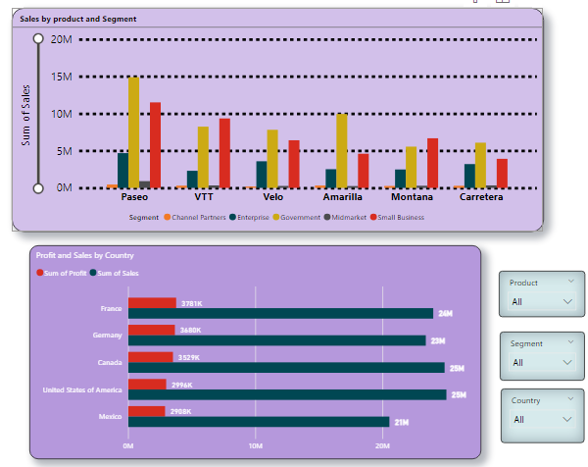
Sales and Profit Analysis by Country
Top Performing Countries:
France has generated the highest profit across all segments.
Canada and USA have equal sales, but Canada outperforms USA in profit.
Top Performing Products:
Velo, Paseo, Amarilla, VTT, Montana, and Carretera have earned the highest profits in the Government segment.
Paseo stands out as the highest-demand and most profitable product across all segments.
Underperforming Segments:
Small Business has shown good profit performance.
Channel Partner and Midmarket segments are underperforming in both sales and profit.
Measure:
Midmarket and Channel Partner segments need attention to boost revenue. Targeting product performance in these segments across countries is crucial for growth.

Slide 7
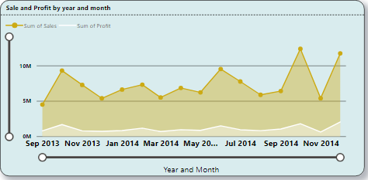
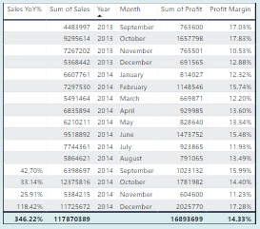
Sales and Profit Trends by year and Month 1. Sales growth: there was a significant increase in sales from 2013 to 2014. Profit growth: profit also increased from 2013 to 2014 2. Monthly variations: sales: sales fluctuated considerably month-to-month. December 2014 had the highest sales volume. November 2013 had the lowest sales volume. Profit: profit also varied across months, with december 2014 being the most profitable and september 2013 being the least. 3. Year-over-year comparison: the "sales yoy%" column shows the percentage change in sales compared to the same month in the previous year. For example, a 42.70% value in september 2014 indicates that sales in september 2014 were 42.70% higher than in september 2013. 4. Profitability: profit margins varied across months, indicating potential areas for improvement. Profit margins varied across months. Measure: there might be seasonal patterns in sales and profit, which shown in graph that increase in certain period like seasonal demand increase or decrease of product as well as need to focus on internal and external factors

Slide 8
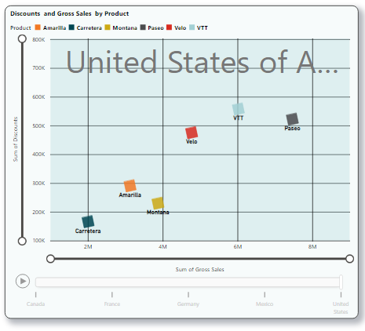
Discount V/s Gross Sales by Product and Country
The overall trend suggests a positive correlation between discounts and gross sales. In general, products with higher discounts tend to generate higher gross sales but in some of product might be varies
Positive Correlation: Across all countries (Canada, France, Germany, Mexico, and the United States), there's a general positive relationship between discounts and gross sales.
Paseo: Consistently demonstrates high discounts and high gross sales across all countries, indicating a strong response to discounts.
Carretera: Generally, shows lower discounts and lower gross sales, suggesting a potential need for alternative pricing or promotional strategies.
Other Products: Amarilla, Montana, Velo, and VTT exhibit varying levels of performance across countries, indicating potential influences of regional preferences or market conditions.
Measure: Due to competitors, Discount Strategies need to focus on proper implementation and execution of sales according to strategies and how other products can improved their potential in different region.

Slide 9
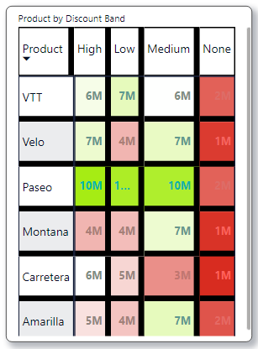
A matrix visualization with Heatmap Effect (Product by Discount)
Red represents low sales
White and Baby Pink represents moderate sales
Green represents high
Paseo:
High sales across all discount bands except "None".
Action: Test reduced discounting or premium pricing strategy.
VTT:
Strong sales with discounts; low sales without discounts.
Action: Evaluate lower discount levels to increase profitability.
Carretera:
Best performance with high discounts.
Action: Investigate product positioning; explore non-discount promotions.
Montana and Amarilla:
Moderate sales, higher in "Medium" and "High" bands.
Action: Focus on medium-level discounts to optimize margins.
Velo:
Discount-sensitive; significant drop in sales with no discount.
Action: Introduce bundling strategies or loyalty programs.
Measure : Need to focus on area where sales is affected in spite of giving discounts so need to work on discount and selling strategy.

Slide 10
The Output of Finance Performance Dashboard
Recommendations:
Optimize Discount Strategies: Further analyze profitability for each product and discount band to determine the most effective discount levels for each product and market.
Target High-Performing Products: Focus on optimizing marketing and promotional efforts for products like Paseo that show strong responses to discounts.
Monitor Competitor Activity: Continuously monitor competitor pricing and discounting strategies to adjust pricing and promotions accordingly.
Investigate Seasonality: Analyze sales and profit trends over a longer period to identify potential seasonal patterns and adjust inventory and marketing strategies accordingly.
Improve Profit Margins: Analyze factors impacting profit margins and identify areas for improvement, such as cost optimization or pricing adjustments.

Slide 11
Thank You

